Slide 1
PREETHI ASHRITHA GUNNAM
KEYLOGGER & SECURITY
Final Project.

Slide 2
Keylogger & security
Keylogging is a powerful cybersecurity tool that records every keystroke on a target device, providing valuable insights into user activity and potential security breaches.
As a security tool, keyloggers are often employed by cybersecurity professionals and system administrators to monitor and analyze user activity on a network or a specific system.

Slide 3
Agenda
Problem Statement.
Project Overview.
Who are the end users ?
Solution and value proposition.
The “Wow” factor in our solution.
Modelling.
Results.

Slide 4

PROBLEM STATEMENT
As a security tool, keyloggers are often employed by cybersecurity professionals and system administrators to monitor and analyze user activity on a network or a specific system. They can help identify suspicious behavior, detect unauthorized access, and provide valuable information for forensic analysis in the event of a security incident.

Slide 5

PROJECT OVERVIEW
Understand the Risks
Conduct a thorough risk assessment to identify vulnerabilities and potential threats.
Evaluate Keylogging Solutions
Research and compare different keylogging technologies, considering their features, capabilities, and privacy implications.

Slide 6
WHO ARE THE END USERS?
IT Administrators Use keylogging to monitor system activity, detect suspicious behavior , and respond to security incidents.
Security Analysts Leverage keylogging data to investigate potential breaches, conduct forensic analysis, and enhance security protocols.
Compliance Officers Utilize keylogging to ensure adherence to regulatory requirements and industry best practices.
Researchers Analyze keylogging data to uncover patterns, trends, and vulnerabilities, informing ongoing security improvements.

Slide 7
OUR SOLUTION AND ITS VALUE PROPOSITION
Comprehensive Monitoring
Robust Security
Our keylogging solution provides a complete record of user activity, including keystroke logs, screenshot captures, and network traffic monitoring.
Military-grade encryption and secure storage ensure the confidentiality and integrity of sensitive keylogging data.

Slide 8

THE WOW IN OUR SOLUTION
Innovative Approach
Combining technical measures with user education for comprehensive protection.
Automated Reporting
Customizable reports and dashboards provide comprehensive visibility into system health and security posture.

Slide 9
MODELLING
Pilot Implementation
Test the keylogging solution in a controlled environment to validate functionality and identify any issues.
Customization
Tailor the solution to meet the specific requirements and policies of the organization.
Enterprise-Wide Rollout
Deploy the keylogging solution across the organization, providing training and support to end users.
Ongoing Monitoring
Continuously monitor the performance and effectiveness of the keylogging solution, making iterative improvements as needed.

Slide 10
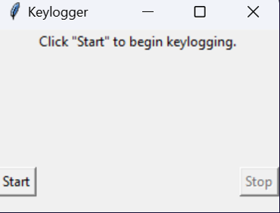
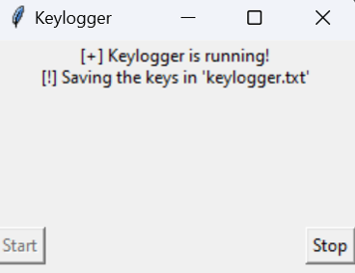
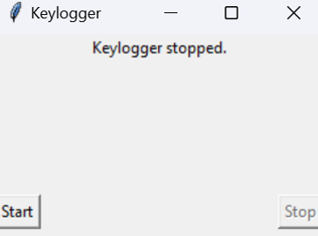
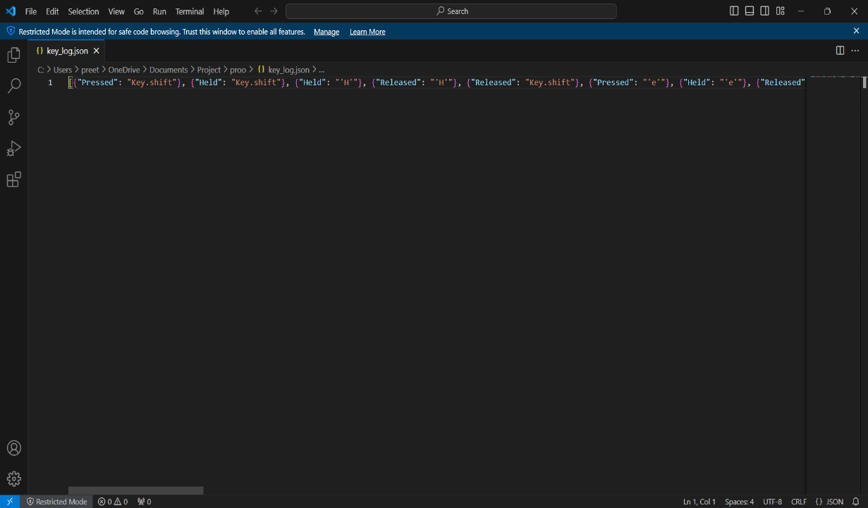
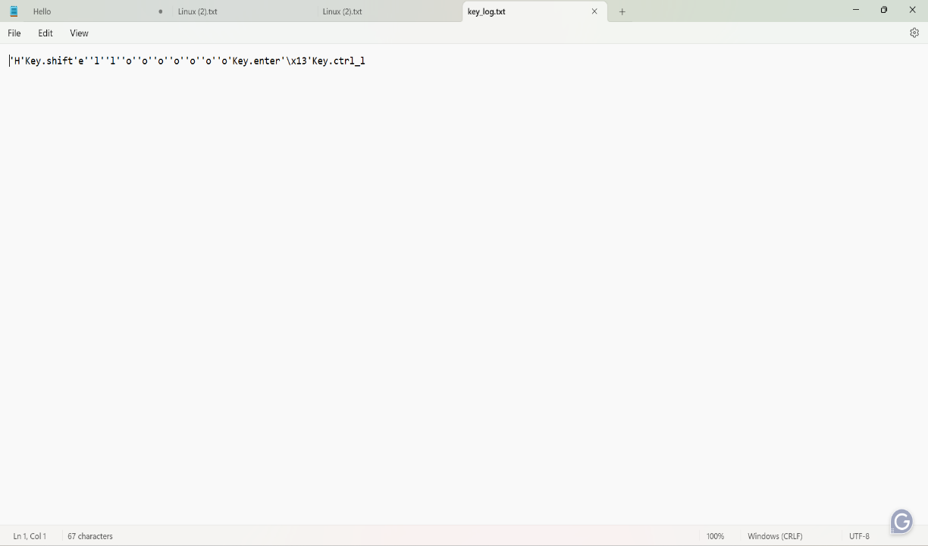
RESULTS

Slide 11
LINK:
https://github.com/PREETHI-ASHRITHA/cybersecurity.git

